Slide 1



Instructions
Open the URL below or with the QR-Code https://tinyurl.com/kargo-edgecase-2024 Once there, start with executing the first 2 steps
fullstaq.com

Slide 2



Your first experience
with Kargo

Slide 3




Bas Bremer
Cloud Native Engineer
b.bremer@fullstaq.com
www.linkedin.com/in/bas-bremer
fullstaq.com

Slide 4

Hidde Beydals
Staff Software Engineer (Kargo)
Hidde@akuity.io
https://www.linkedin.com/in/hiddebeydals
fullstaq.com

Slide 5

Table of Content
What is Kargo?
01
For who is Kargo?
02
How does Kargo Work?
03
Key concepts
04
Workshop time!
05
fullstaq.com

Slide 6



Who knows ArgoCD?
fullstaq.com

Slide 7

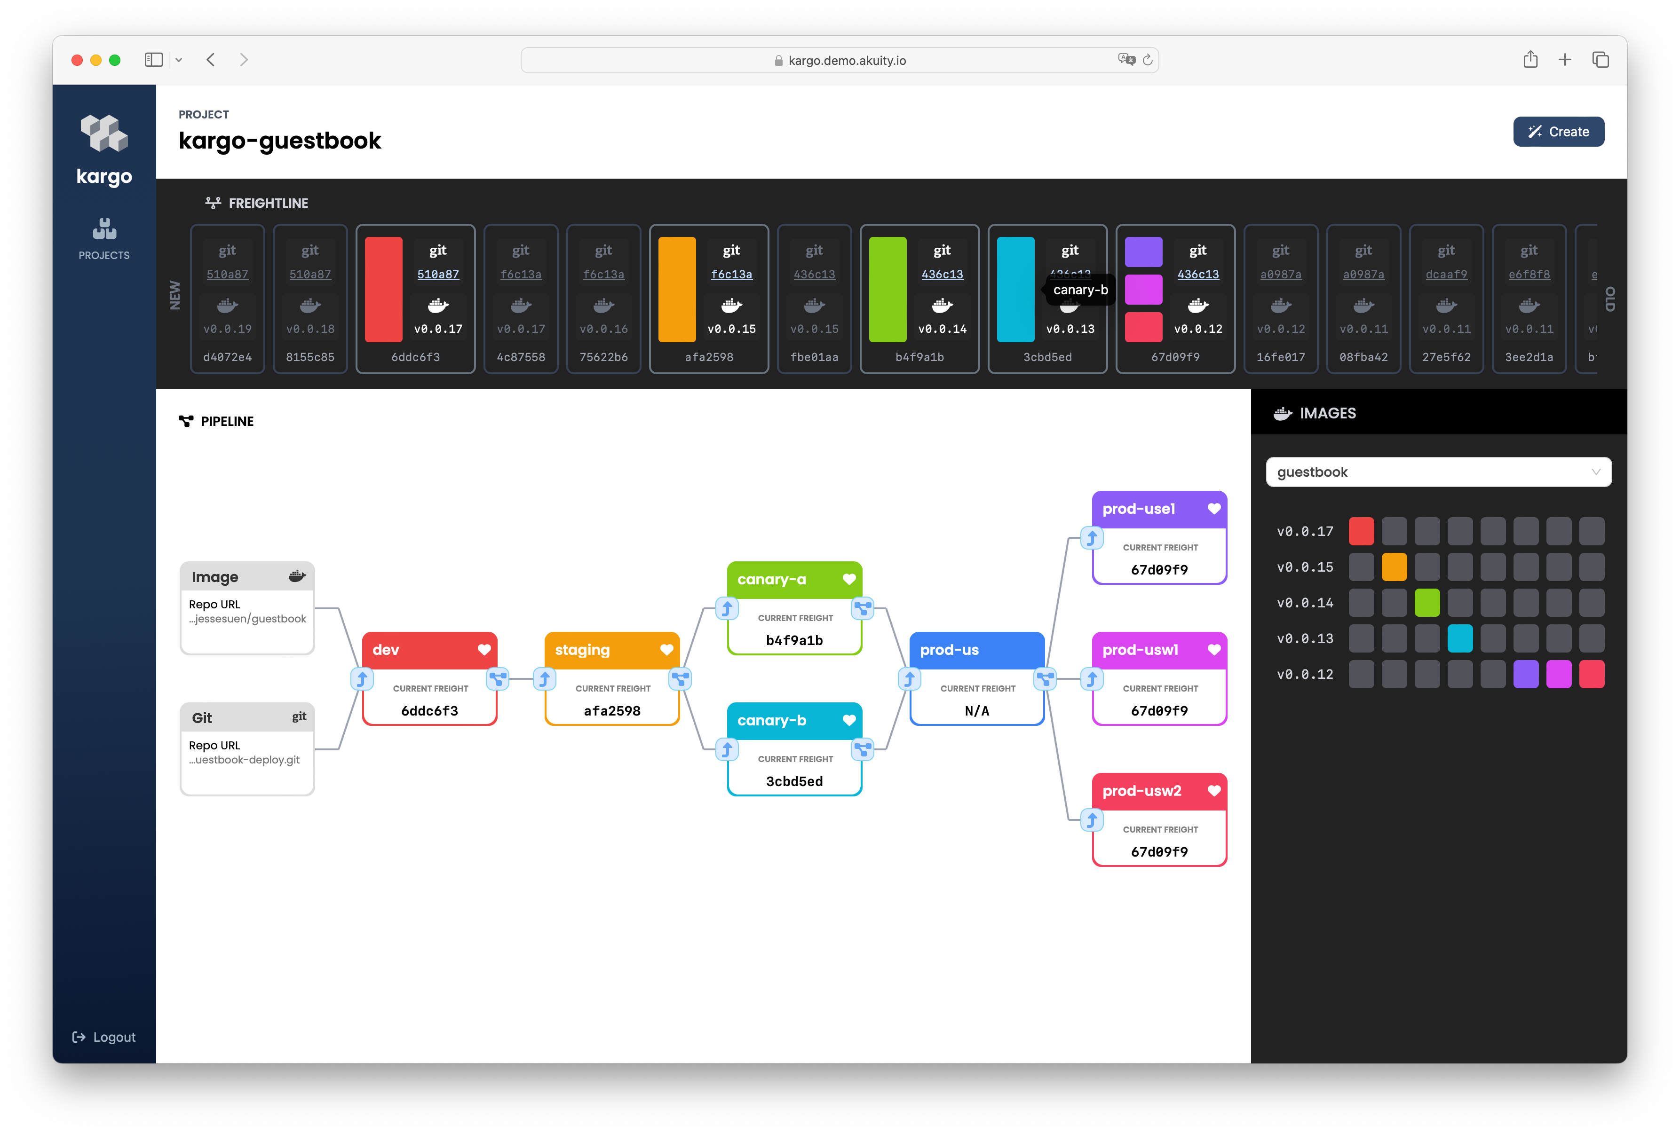
Who knows Kargo?
fullstaq.com

Slide 8
What is Kargo?
Next-generation Continues Delivery platform
Provides:
GitOps way of working
Flexibility
Intuitive dashboard
Safer deployments
Testing and verification
fullstaq.com
Notes:
Kargo is a next-generation continuous delivery and application lifecycle orchestration platform for Kubernetes.
Kargo provides:
GitOps way of working
Flexible pipeline to promote changes in multiple stages
Dashboard for visualizing changes across your stages
Intuitive UX that hides nuances of GitOps
Safer deployments with enforced processes and guardrails
Testing and verification between stages

Slide 9
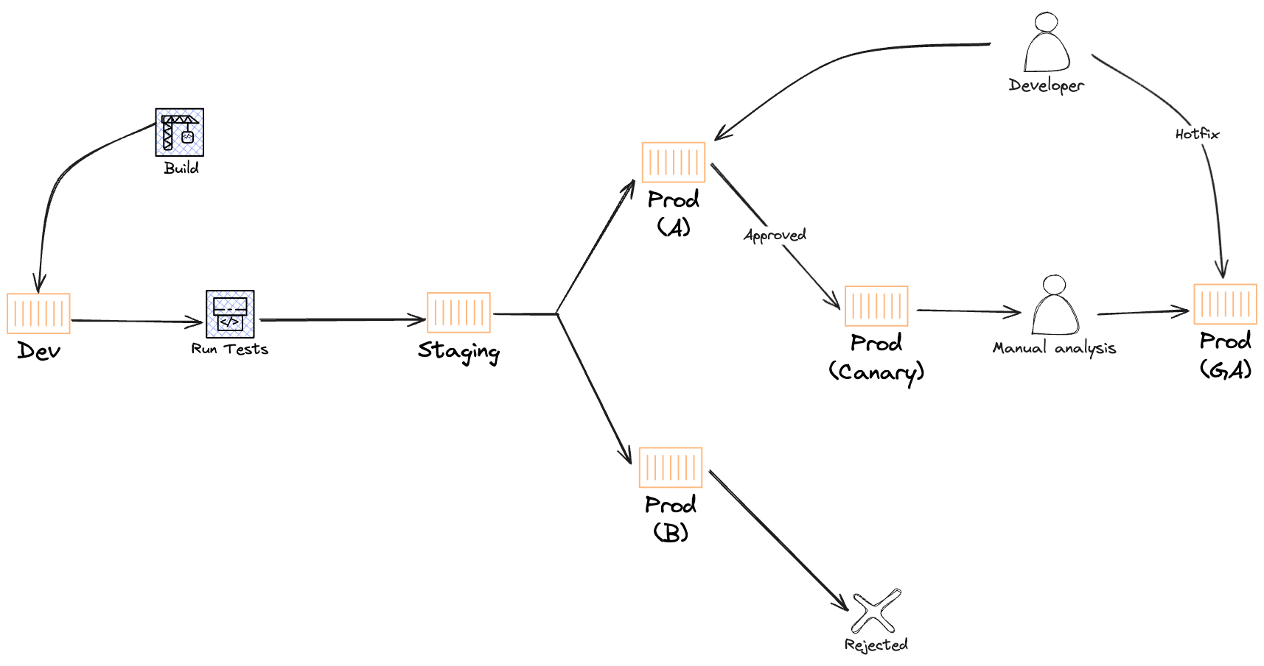
For who is Kargo?
Complex deployment pipelines
Multiple stages
Multiple targets
Use cases:
A/B testing
Canary Deployments
Continues verification
source: https://www.youtube.com/watch?v=Pto7QnxkjjA
fullstaq.com
Notes:
Deploy pipelines are getting more complex!
When you have multiple environments and regions to deploy to.
When advanced promotion techniques are desired, such as:
Progressive Delivery: A/B testing, Canary
Continuous Verification

Slide 10
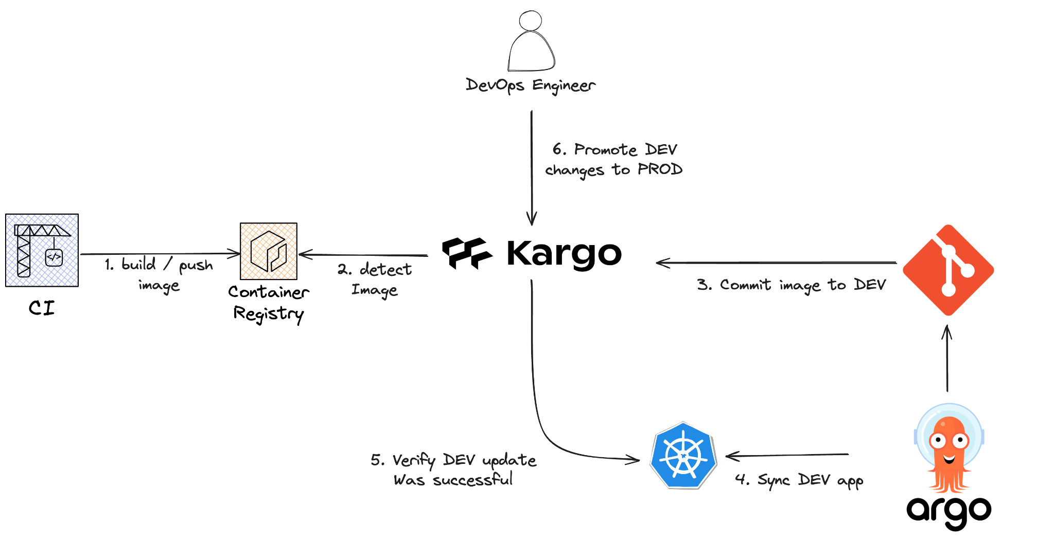
How does Kargo work?
source: https://www.youtube.com/watch?v=yaZc0DdeLKk
fullstaq.com

Slide 11

What about ArgoCD?
It does
Deploy to a single target
It doesn’t
Understand relationships
Pipeline to orchestrate changes
Write changes to Git
Verify updates
fullstaq.com

Slide 12
Key concepts
Project
Freight
Warehouse
Stage
Promotion
fullstaq.com
Notes:
Approval, not a key concept but very important
Will be handled during the workshop.

Slide 13
Key concepts - Project
Collection of related Kargo resources such as:
RBAC
Stages
Warehouses
Freight
Creates a Kubernetes namespace
fullstaq.com
Notes:
A way to bundle Kargo components

Slide 14
Key concepts - Freight
Second most important concept
Contains
Container images;
Kubernetes manifests
Helm charts
Meta-artifact
fullstaq.com
Notes:
Freight is Kargo's second most important concept. A single "piece of freight" is a set of references to one or more versioned artifacts, which may include one or more:
Container images (from image repositories)
Kubernetes manifests (from Git repositories)
Helm charts (from chart repositories)
Freight can therefore be thought of as a sort of meta-artifact. Freight is what Kargo seeks to progress from one stage to another.

Slide 15
Key concepts - Warehouse
Source of Freight
Contains
Container image repositories
Git repositories
Helm chart repositories
Detects changes, creates new pieces of freight
fullstaq.com
Notes:
A warehouse is a source of freight. A warehouse subscribes to one or more:
Container image repositories
Git repositories
Helm charts repositories
Anytime something new is discovered in any repository to which a warehouse subscribes, the warehouse produces a new piece of freight.

Slide 16
Key concepts - Stage
Most important concept of Kargo
Purpose not location
Subscription and promotion mechanisms
Verification
Typical stages are:
Dev
Test
Acc
Prod
fullstaq.com
Notes:
A stage resource defines the subscription and promotion mechanisms for an instance of an application.
The critical feature of a stage is that its name (e.g. "test", "prod") denotes an application instance's purpose and not its location.
Typical stages are:
Dev
Test
Staging
Production
Can contain verification
Subscription to freight or another stage
Kargo’s most important concept

Slide 17
Key concepts - Promotion
A promotion is a request to move a piece of freight into a specified stage.
fullstaq.com

Slide 18
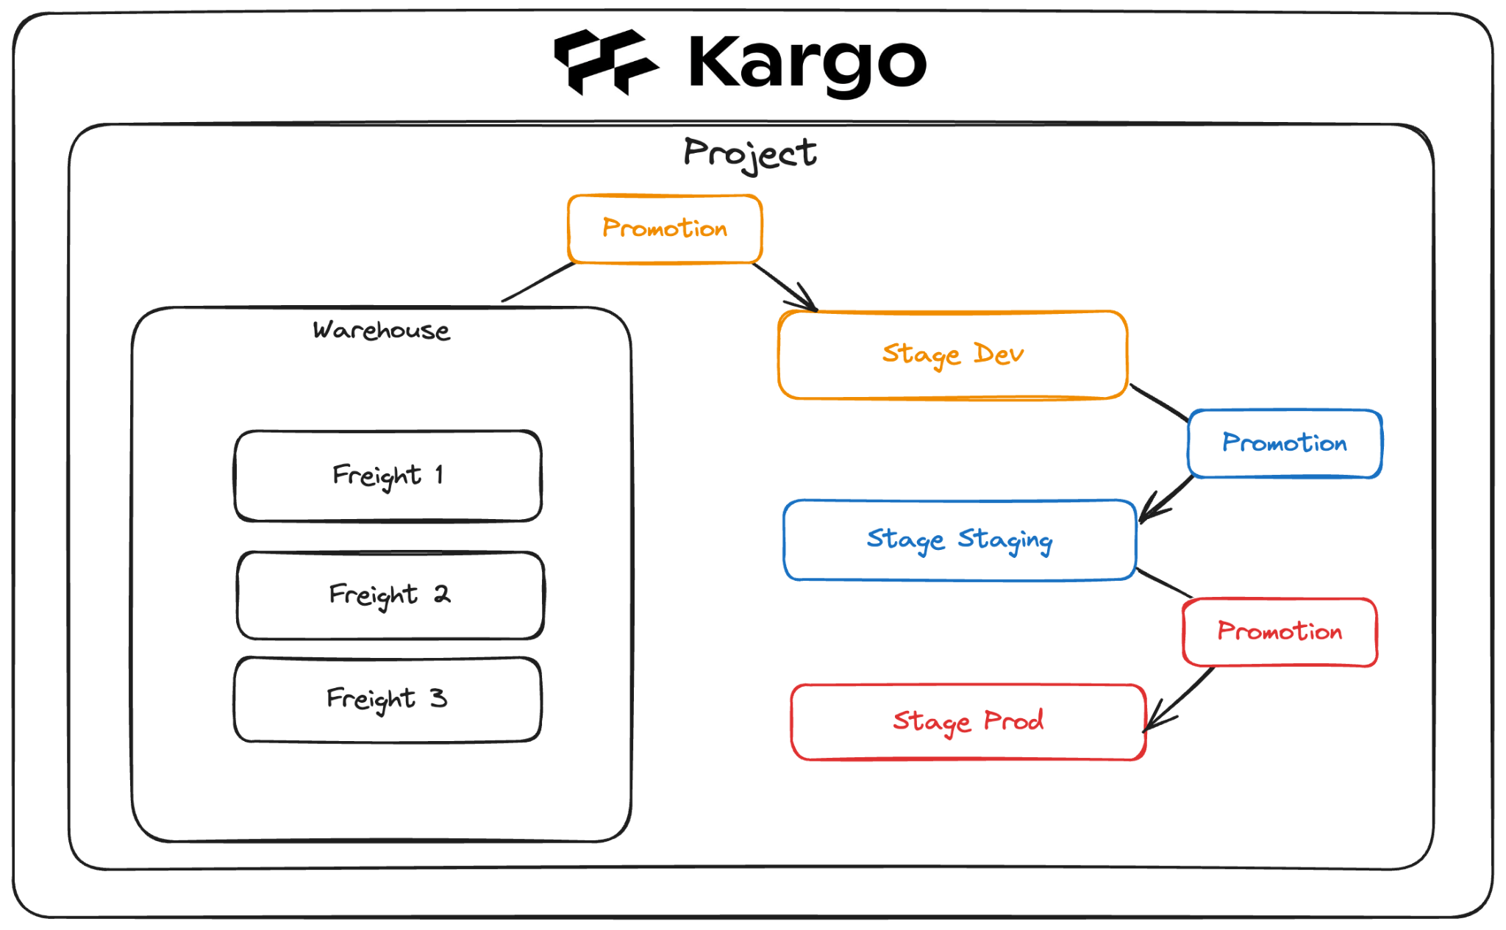
Key concepts - Architecture
Approval
fullstaq.com

Slide 19

fullstaq.com

Slide 20

QUESTIONS
fullstaq.com

